Slide 1
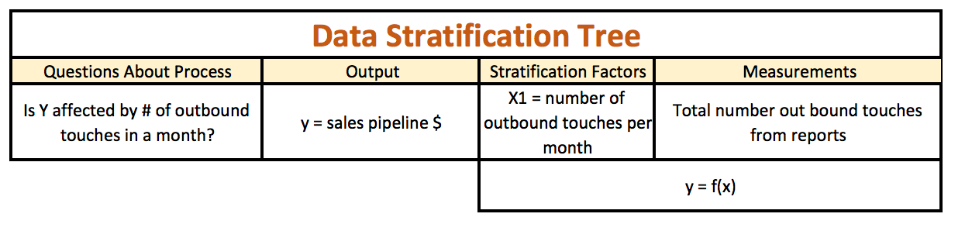
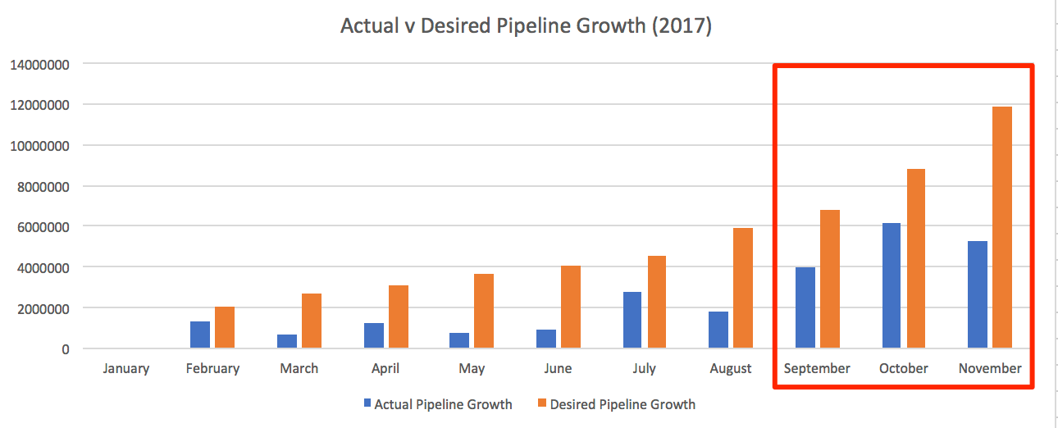
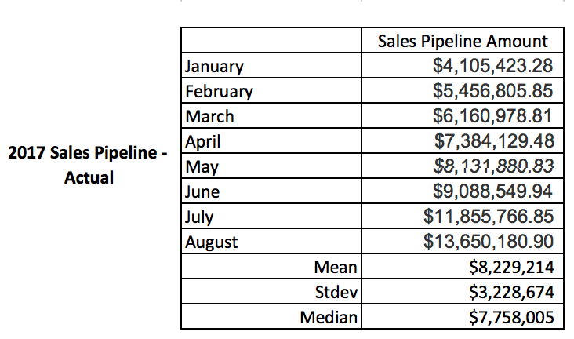
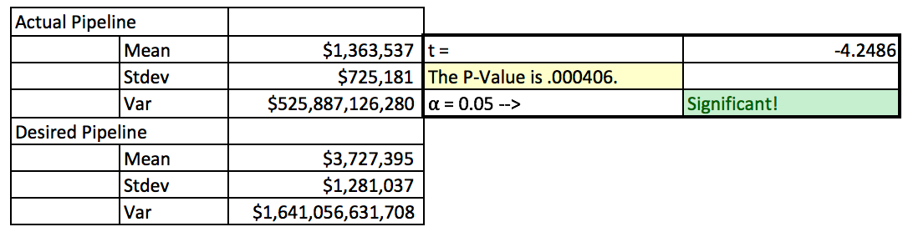
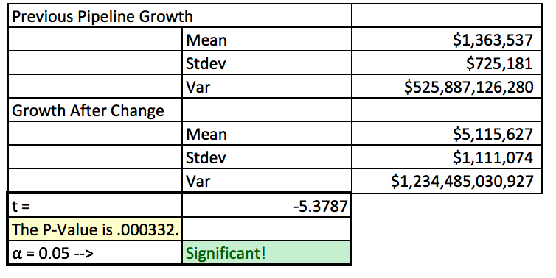
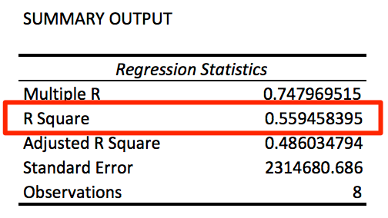
ANALYZE
DEFINE
MEASURE
Sales Pipeline Growth
Pipeline amounts and number of outbound touches are positively correlated!
R = 0.75
Nate Hoffelmeyer
Problem
IMPROVE
- Can pipeline increase from historic? Not to desired.
- Mandate CRM data entry
- Set weekly outbound touch goals
Sales pipeline growth at company is too slow.
We need to accelerate pipeline to show investors we can generate opportunity / interest in our product.
Hitting “desired” not important; but meaningful growth crucial.
Identified inputs and outputs for measure
Ha: average actual pipeline growth significantly lower than desired → p < 0.05 = reject Ho
Pipeline mostly flat and lags below desired.
Number of touches = a predictor of pipeline $ amount!
R² = 0.56
Investors see rapid pipeline increase
Company receives more funding.
Customers indicate interest in purchasing product
Sales reps reach out to prospects and customers
Growth significantly higher after change
SQL = 3.04
SQL = 2.72
Outbound touches mostly flat
CONTROL
Outreach tracking has been automated through software tools
Weekly meetings hold employees accountable for updating data prior to every weekend
Managers rated on team activity weekly

Slide 2
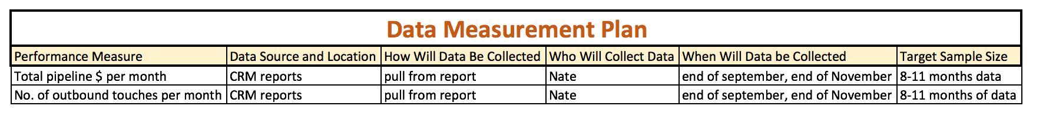
Sales Pipeline Growth
Nate Hoffelmeyer

Slide 3
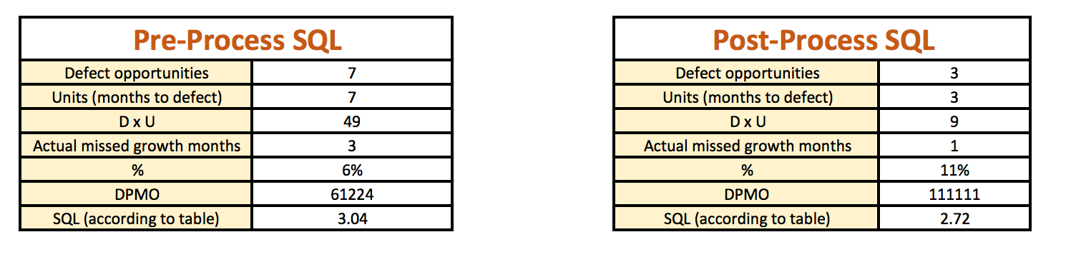
Sales Pipeline Growth
Nate Hoffelmeyer
Defect Defined as a month where pipeline didn’t grow relative to the previous month.
Sample size being so small may have lead to measurement error w.r.t. sigma level as accurately represented post process

Slide 4
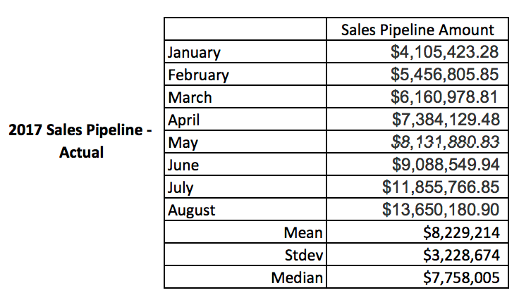
Sales Pipeline Growth
Define the Problem
Nate Hoffelmeyer
The company needs to show potential investors that it can drive sales growth, specifically as it relates to pipeline management. The requirement is one of many that needs to be presented to the investment group. In this case, the investment group has looked at the selling year up to August 2017 and seen that pipeline growth is not growing fast enough, and has given a desired amount of pipeline growth for the team to benchmark against. Using this information we find the following as it relates to the baseline of pipeline from January to August 2017.
Actual growth of the pipeline has been an average of $1.364 million, where the investment group desires an average of $3.727 million for this same period. After discussions, the investment group has conceded that catching up to the desired pipeline growth will not be possible, and is not necessary for them to invest. All that is required, is to show a meaningful and statistically significant increase in pipeline growth – and explain why this was achieved, such that they know what type of process they’re betting on.
The investment group has noted that the company is losing operating runway, burning cash at a rate higher than it is collecting cash, and accordingly needs $30 million in funding. Thus, if this process is improved the company stands to raise a large round of capital, and keep the lights on for another (yet to be determined) runway period.

Slide 5
Sales Pipeline Growth
Measure the Data
Nate Hoffelmeyer
After discussing with the investment group, the company takes a look at historical information pertaining to outreach by company representatives to prospects & customers and pipeline growth. Through research, the company determines that, though Pipeline is increasing, and though they know not enough, monthly touches appear to be relatively flat. Here we see actual pipeline growth monthly compared to desired growth – and total number of outbound touches, also monthly.

Slide 6
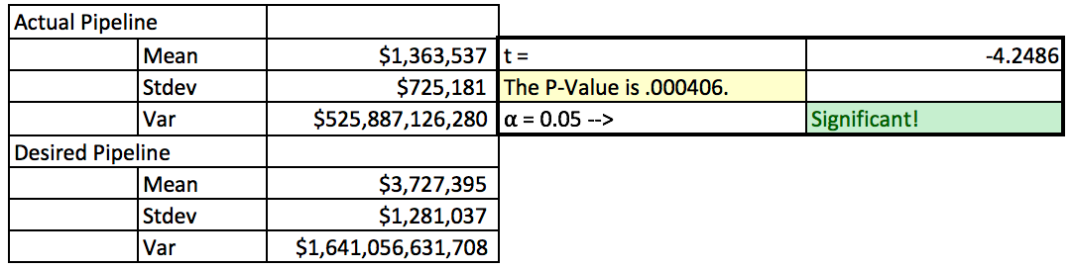
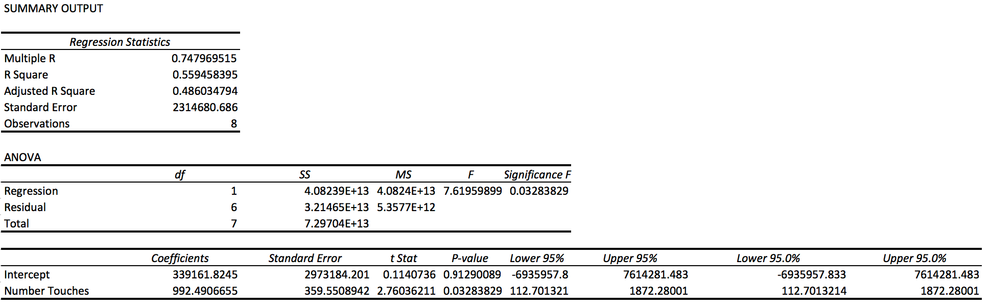
Sales Pipeline Growth
Analyze the Data
Nate Hoffelmeyer
Analysis yields a relatively strong, positive, correlation between the amount of pipeline growth and number of outbound touches to prospects & customers.
R = 0.75
The company sets out to prove that pipeline growth through August has been significantly lower than desired to make the case to the executive board that the investment group is right and a change is needed. Setting an alpha of 0.05, the company runs a t-test for the months of pipeline growth from January through August, yielding the following results that the lack of growth is significantly different (i.e. worse) than the desired growth in pipeline.
To ensure that there is more evidence beyond the correlation and significance, and to triple check, the company runs a linear regression analysis on the pipeline growth and number of outbound touches, finding an Rsquare of 0.56, and indication of positive influence by touches on pipeline growth.
R² = 0.56

Slide 7
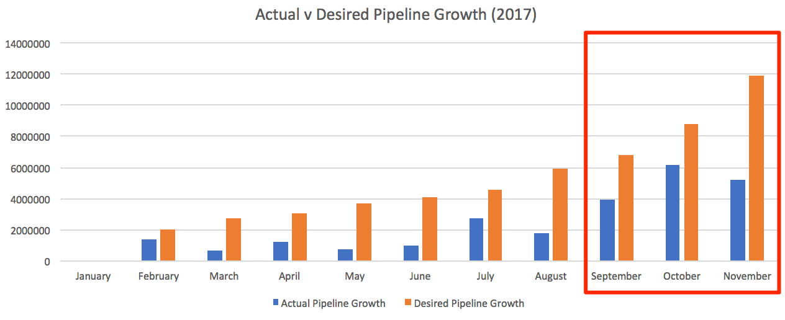
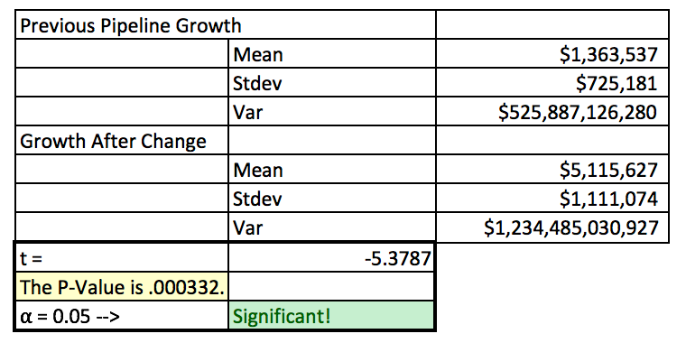
Sales Pipeline Growth
Improve the Process
Nate Hoffelmeyer
After the analysis, the company decides to implement a mandatory data entry policy by representatives to the customer relationship management (CRM) platform. The company does this by investing in software tools to automate the tracking of outbound touches, and also tasks the managers with weekly outbound touch number goals.
For three months the company tests this implementation: September, October, and November of 2017. Afterward the results are gathered and compared to the desired results of the investment group, and also the data from Jan – Aug, considering the investment group specified a significant increase would be acceptable.
Though the company was not able to hit the desired growth targets, they were able to show a meaningful increase in the growth of pipeline for the Sep – Nov period, following implementation of their outbound touches process.

Slide 8
Sales Pipeline Growth
Control the Process
Nate Hoffelmeyer
Following the understanding of improvement regarding pipeline growth, the company has decided to implement Yesware email and call tracking to automate the entry of outbound touches into the sales crm. This will allow management to hold team members accountable for the outreach goals, and with manual data entry off the table will, the company hopes, allow for a focus on content generation for further more targeted outreach.
Though the company is in its early stage and has not implemented many control features, because of this project the company is open to considering the implementation of process control charts. This is not something that has been implemented yet, but as the company enters 2018 it is explore this as the measure of control for the sales pipeline growth process.

Slide 9
Sales Pipeline Growth
Nate Hoffelmeyer
Process Improvement Questions
Data collected for this project is revenue (money) data, as well as outbound sales activity – defined as any outbound touchpoint recorded from our company to the customer.
The data is continuous data, over time.
Yes – clear operational and industry standards have been set and mentioned above.
Existing company data was pulled for this project.
Here we are looking at current year’s data – about 11 months. Overall we look at 8 months of data for the ”old process”, and 3 months of data for the ”new” process.
Data is tracked by the company in the company’s CRM system, and I built a set of reports to call on this information.
The data of the reports is only as good as the data gone in. If a system that records outbound touches went down, for instance, we might lose outbound touch data and if nobody manually backfilled that touch it would be gone forever. Money wise, someone could mistype an amount or fail to accurately represent a pipeline opportunity amount and this would lead to incorrect error. We minimize measurement error here by using said automated systems for touchpoint recordings, and we audit our CRM $ information with our accounting system at the end of each month for reconciliation.

Slide 10
Sales Pipeline Growth
Nate Hoffelmeyer
Process Improvement Questions (cont.)
8) The data here tells us that number of touches does significantly impact the amount of $ in the pipeline. Thus we discovered that simply having more “sales” activity will lead to more sales pipeline. The next phase, for 2018 and beyond, will be understanding if there are specific types of outreach or content delivered in those outreaches that has a bigger impact.
9) After the solution was proposed to make more calls and send more emails, the company has mandated a set amount of touchpoints per team per week, month, and quarter. Further solutions being proposed now for the 2018 year are around specific content, for which we don’t yet have data historically as we haven’t tracked “content used”. Going forward, we are implementing a template process, whereby certain campaigns and templates will be used. Those templates and campaigns will then be tracked for effectiveness and we will be able to see if certain content resonates more with customers in an effort to help us drive even more sales pipeline amounts.

